Slide 1

MACHINE LEARNING
UNIT – III
ENSEMBLE TECHNIQUES
AND UNSUPERVISED LEARNING

Slide 2
COMBINING MULTIPLE LEARNERS
Combining multiple learners is a machine learning technique that combines multiple
models into a single model. The goal is to improve the model's performance by
combining the weak learners in the right way.
Rationale :
• The No Free Lunch Theorem states that there is no single learning algorithm that in any
domain always induces the most accurate learner. The usual approach is to try many and
choose the one that performs the best on a separate validation set.
Different Learners use Different
• Algorithms: making different assumptions
• Hyper parameters: e.g. number of hidden nodes in NN, k in k-NN
• Representations: different features, multiple sources of information
Training sets: small variations in the sets or different subproblems

Slide 3
COMBINING MULTIPLE LEARNERS
Different Algorithms
Different algorithms make different assumptions about the data and lead to
different classifiers.
Different Hyper parameters
Use the same learning algorithm but use it with different hyper parameters.
Different Input Representations
Separate base-learners may be using different representations of the same input object or event, making it possible to integrate different types of Sensors/ measurements/ modalities.
Different representations make different characteristics explicit allowing better identification.
Different Training Sets
Another possibility is to train different base-learners by different subsets of the training set. This can be done randomly by drawing random training sets from the given sample this is called bagging.

Slide 4
COMBINING MULTIPLE LEARNERS
Model Combination Schemes
There are also different ways the multiple base-learners are combined to generate
the final output:
Multi expert combination
Multi expert combination methods have base-learners that work in parallel methods
can in turn be divided into two:
The global approach, also called learner fusion, given an input, all base-learners
generate an output and all these outputs are used.
Examples are voting and stacking.
B) The local approach, or learner selection, for example, in mixture of experts, there
is a gating model, which looks at the input and chooses one (or very few) of the learners
as responsible for generating the output.

Slide 5

COMBINING MULTIPLE LEARNERS
1. Serial Approach:
Next base-learner focuses on instances where previous base-learners are inaccurate.
2. Base Learners:
𝐿: Number of base-learners. 𝑑𝑗(𝑥)d j​ (x): Prediction from base-learner 𝑀𝑗 for input 𝑥.
3. Input Representation:
Each learner 𝑀𝑗M j​ uses a unique input representation 𝑥𝑗x j​ , possibly with transformations.
4. Final Prediction:
Predictions from base-learners are combined using a function: 𝑌=𝑓(𝑑1,𝑑2,…,𝑑𝐿∣Φ)
𝑓(⋅): Combining function. Φ: Parameters of the combining function.
5. Multi-Class Classification:
𝐾: Number of output classes. Each learner 𝑀𝑗 generates 𝐾 predictions, 𝑑𝑗𝑖(𝑥).
Combine predictions to produce final 𝐾 values, 𝑦𝑖.
6. Classification Decision:
Predicted class: Class with the maximum 𝑦𝑖 value is chosen.

Slide 6
COMBINING MULTIPLE LEARNERS
Voting :
• A Voting Classifier is a machine learning model that trains on an ensemble of numerous models and predicts an output (class) based on their highest probability of chosen
as the output.
• It simply aggregates the findings of each classifier passed into Voting Classifier and
predicts the output class based on the highest majority of voting.
• The idea is instead of creating separate dedicated models and finding the accuracy for
each them, create a single model which trains by these models and predicts output based
on their combined majority of voting for each output class.
• The simplest way to combine multiple classifiers is by voting, which corresponds to
taking a linear combination of the learners .
• This is also known as ensembles. In the simplest case, all learners are given equal weight
and simple voting corresponds to take an average.

Slide 7
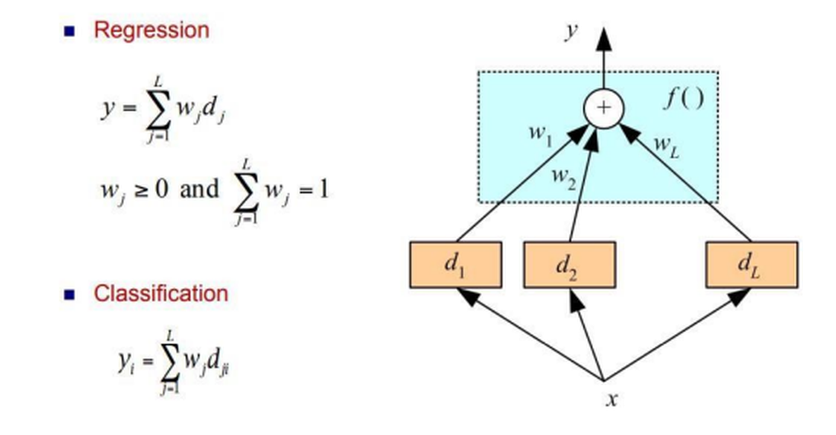
COMBINING MULTIPLE LEARNERS
• Voting Classifier supports two types of voting’s.

Slide 8
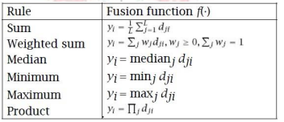
COMBINING MULTIPLE LEARNERS
Hard Voting:
Predicts the class with the highest majority of votes from classifiers.
Example: If three classifiers predict (A, A, B), the majority is A,becomes the final prediction.
2. Soft Voting:
Predicts the class based on the average probability assigned by classifiers.
Example:
Class A probabilities: (0.30, 0.47, 0.53) → Average = 0.4333.
Class B probabilities: (0.20, 0.32, 0.40) → Average = 0.3067.
Winner: Class A due to higher average probability.
3. Bayesian Interpretation:
Voting schemes approximate a Bayesian framework
Classifier weights represent prior model probabilities, and model decisions approximate conditional likelihoods.

Slide 9
COMBINING MULTIPLE LEARNERS
Different Algorithms
Different algorithms make different assumptions about the data and lead to
different classifiers.
Different Hyper parameters
Use the same learning algorithm but use it with different hyper parameters.
Different Input Representations
Separate base-learners may be using different representations of the same input object or event, making it possible to integrate different types of Sensors/ measurements/ modalities.
Different representations make different characteristics explicit allowing better identification.
Different Training Sets
Another possibility is to train different base-learners by different subsets of the training set. This can be done randomly by drawing random training sets from the given sample this is called bagging.

Slide 10
COMBINING MULTIPLE LEARNERS
Different Algorithms
Different algorithms make different assumptions about the data and lead to
different classifiers.
Different Hyper parameters
Use the same learning algorithm but use it with different hyper parameters.
Different Input Representations
Separate base-learners may be using different representations of the same input object or event, making it possible to integrate different types of Sensors/ measurements/ modalities.
Different representations make different characteristics explicit allowing better identification.
Different Training Sets
Another possibility is to train different base-learners by different subsets of the training set. This can be done randomly by drawing random training sets from the given sample this is called bagging.

Slide 11
LEAST SQUARES REGRESSION LINE
Model Combination Schemes
✓ There are also different ways the multiple base-learners are combined to
generate the final output:
➢ Multiexpert combination o Multiexpert combination methods have
base-learners that work in parallel. methods can in turn be divided
into two:
A) The global approach, also called learner fusion, given an input, all
base-learners generate an output and all these outputs are used.
Examples are voting and stacking.
B) The local approach, or learner selection, for example, in mixture of
experts, there is a gating model, which looks at the input and
chooses one (or very few) of the learners as responsible for
generating the output

Slide 12
LEAST SQUARES REGRESSION
Scenario:
A rocket motor is manufactured by combining an igniter propellant and a sustainer propellant inside a strong metal housing. It was noticed that the shear strength of the bond between two propellers is strongly dependent on the age of the sustainer propellant.
Problem Statement:
Implement a simple linear regression algorithm using Python to build a machine learning model that studies the relationship between the shear strength of the bond between two propellers and the age of the sustainer propellant.

Slide 13
LEAST SQUARES REGRESSION
Step 1: Import the required Python libraries.
import numpy as np
import pandas as pd
Import matplotlib.pyplot as plt
Explanation:
Pandas - for data manipulation, imported under the pd alias , provides two types:
(1D data like a list) Series; (2D tabular data like an Excel spreadsheet) DataFrame.
Matplotlib - for visualizing the results, imported under the plt alias,
pyplot module provides an easy interface to create plots and charts.
NumPy - provides the ndarray object for creating and manipulating
n-dimensional arrays (faster than Python lists), imported under the np alias.

Slide 14
LEAST SQUARES REGRESSION
Step 2: Next step is to read and load the dataset.
data = pd.read_csv('PropallantAge.csv’)
data.head()
data.info()
Explanation:
This line reads a CSV (Comma-Separated Values) file named PropallantAge.csv into a pandas DataFrame.
pd.read_csv() is a pandas function used to load a dataset from a .csv file.
data.head() is a pandas method that retrieves the first few rows of the DataFrame.
data.info() it summarizes the structure of the dataset, including column data types and missing values

Slide 15
LEAST SQUARES REGRESSION
Step 3: Create a scatter plot just to check the relationship between these variables.
plt.scatter(data['Age of Propellant'],data['Shear Strength’])
Explanation:
plt.scatter() - generate the scatter plot, displays data points on a two-dimensional plane, showing the relationship between two variables.
Each data point is represented specific observation (row) in the dataset by a marker
(e.g., a dot) with its position determined by the values of the two variables:
The Age of Propellant column is plotted on the X-axis(independent variable).
The Shear Strength column is plotted on the Y-axis(dependent variable).

Slide 16
LEAST SQUARES REGRESSION
Step 4: Next step is to assign X and Y as independent and dependent variables.
X = data['Age of Propellant'].values
Y = data['Shear Strength'].values
Explanation:
data - pandas DataFrame, which is a tabular data structure. It contains rows and columns, where each column can be accessed using its name.
data['Age of Propellant']: Retrieves the 'Age of Propellant' column as a Pandas Series object data['Shear Strength’]: Retrieves the `'Age of Propellant'` column as a Pandas Series object.
.values attribute extracts the data from the Pandas Series and converts it into a NumPy array.
Example: If the column had values [10, 20, 30], then X = array([10, 20, 30]).
Example: If the column had values [50, 40, 30], then Y = array([50, 40, 30]).

Slide 17
LEAST SQUARES REGRESSION
Step 5: Compute the mean of variables X and Y
to determine the values of slope (m) and y-intercept.
# Mean of variables X and Y
mean_x = np.mean(X)
mean_y = np.mean(Y)
# Total number of data values n = len(X)
Explanation :
np.mean(X):Calculates the average of all values in the independent variable X.
mean𝑋=∑𝑋𝑖𝑛mean X​ = n∑X i​ ​ where 𝑋𝑖​ is each value in X, and 𝑛 is the total no. of values. np.mean(Y):Calculates the average of the dependent variable Y mean𝑌=∑𝑌𝑖𝑛mean Y​ = n∑Y i​ ​ The mean of Y is used to center the data along the Y-axis.

Slide 18
LEAST SQUARES REGRESSION
Step 6: Calculate the slope and the y-intercept using the formulas
num = 0
denom = 0
for i in range(n):
num += (X[i] - mean_x) * (Y[i] - mean_y)
denom += (X[i] - mean_x) ** 2
m = num / denom c = mean_y - (m * mean_x)
# Printing coefficients
print("Coefficients") print(m, c)
The above step has given the values of m and c. Substituting them ,
Shear Strength =
2627.822359001296 + (-37.15359094490524)
* Age of Propellant

Slide 19
LEAST SQUARES REGRESSION
Step 7: The above equation represents the linear regression model.
# Plotting Values and Regression Line
maxx_x = np.max(X) + 10
minn_x = np.min(X) - 10
# line values for x and y
x = np.linspace(minn_x, maxx_x, 1000)
y = c + m * x
# Plotting Regression Line
plt.plot(x, y, color='#58b970', label='Regression Line')
# Plotting Scatter Points
plt.scatter(X, Y, c='#ef5423', label='Scatter Plot') plt.xlabel('Age of Propellant (in years)') plt.ylabel('Shear Strength') plt.legend() plt.show()

Slide 20
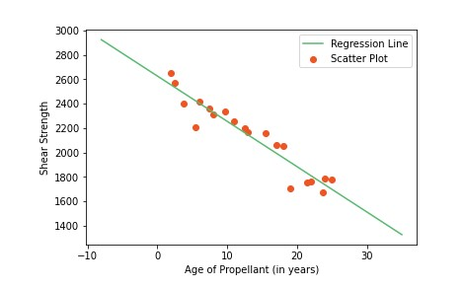
STATISTICAL RELATIONSHIP BETWEEN THE SHEAR STRENGTH AND THE PROPELLANT AGE

Slide 21


STATISTICAL RELATIONSHIP BETWEEN THE SHEAR STRENGTH AND THE PROPELLANT AGE
Types of Linear Regression :
It is of two types: Simple and Multiple.
Simple Linear Regression is where only one independent variable is present and the model has to find the linear relationship of it with the dependent variable
Equation of Simple Linear Regression, where bo is the intercept, b1 is coefficient or slope, x is the independent variable and y is the dependent variable.
In Multiple Linear Regression there are more than one independent variables for the model to find the relationship.
Equation of Multiple Linear Regression, where bo is the intercept, b1,b2,b3,b4…,bn are coefficients or slopes of the independent variables x1,x2,x3,x4…,xn and y is the dependent variable.

Slide 22
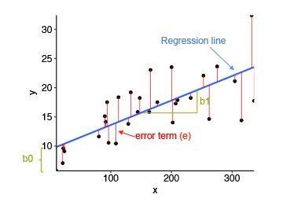
LINEAR REGRESSION MODEL
A Linear Regression model’s main aim is to find the best fit linear line and the optimal values of intercept and coefficients such that the error is minimized.
Error is the difference between the actual value and Predicted value and the goal is to reduce this difference.

Slide 23
LINEAR REGRESSION MODEL
• x is our dependent variable which is plotted on the x-axis and y is the dependent variable which is plotted on the y-axis.
• Black dots are the data points i.e the actual values.
• bo is the intercept which is 10 and b1 is the slope of the x variable.
• The blue line is the best fit line predicted by the model i.e the predicted values lie on the blue line.
• The vertical distance between the data point and the regression line is known as error or residual.
• Each data point has one residual and the sum of all the differences is known as the Sum of Residuals/Errors.

Slide 24
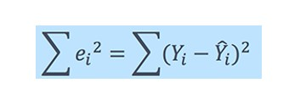

MATHEMATICAL APPROACH:
Residual/Error = Actual values – Predicted Values
Sum of Residuals/Errors = Sum(Actual- Predicted Values)
Square of Sum of Residuals/Errors = (Sum(Actual- Predicted Values)) ²
The aim of Bayesian Linear Regression is to find the “posterior” distribution for the model parameters.
The expression for Posterior is :

Slide 25
BAYESIAN REGRESSION
• Bayesian Regression is used when the data is insufficient in the dataset or the data is poorly distributed.
• The output of a Bayesian Regression model is obtained from a probability distribution.
where
Posterior: It is the probability of an event to occur; say, H, given that another event; say, E has already occurred. i.e., P(H | E).
Prior: It is the probability of an event H has occurred prior to another event. i.e., P(H)
Likelihood: It is a likelihood function in which some parameter variable is marginalized.
• Bayesian Ridge Regression formula is as follows: p(y|λ) = N(w|0, λ^-1Ip) where
'y' is the expected value,
lambda is the distribution's shape parameter before the lambda parameter
the vector "w" is made up of the elements w0, w1,....

Slide 26
IMPLEMENTATION OF BAYESIAN REGRESSION USING PYTHON
• Boston Housing dataset, which includes details on the average price of homes in various Boston neighborhoods.
• The r2 score will be used for evaluation.
• The crucial components of a Bayesian Ridge Regression model:
Program:
from sklearn.datasets import load_boston from sklearn.model_selection import train_test_split from sklearn.metrics import r2_score fromsklearn.linear_model import BayesianRidge
# Loading the dataset of Bayesian Ridge
dataset = load_boston()
X, y = dataset.data, dataset.target

Slide 27
IMPLEMENTATION OF BAYESIAN REGRESSION USING PYTHON
# Splitting the dataset into testing and training sets
X_train, X_test, y_train, y_test = train_test_split
(X, y, test_size = 0.15, random_state = 42)
#Creating to train the model
model = BayesianRidge() model.fit(X_train, y_train)
# Model predicting the test data
prediction = model.predict(X_test)
# Evaluation of r2 score of the model against the test dataset
print(f"Test Set r2 score : {r2_score(y_test, prediction)}")
Output
Test Set r2 score : 0.7943355984883815

Slide 28
INDUCTIVE BIAS
Advantages of Bayesian Regression:
• Very effective when the size of the dataset is small.
• Particularly well-suited for on-line based learning (data is received in real-time), as compared to batch based learning, where we have the entire dataset on our hands before we start training the model. This is because Bayesian Regression doesn’t need to store data.
• The Bayesian approach is a tried and tested approach and is very robust, mathematically. So, one can use this without having any extra prior knowledge about the dataset.
Disadvantages of Bayesian Regression:
• The inference of the model can be time-consuming.
• If there is a large amount of data available for our dataset, the Bayesian approach is not worth it.

Slide 29
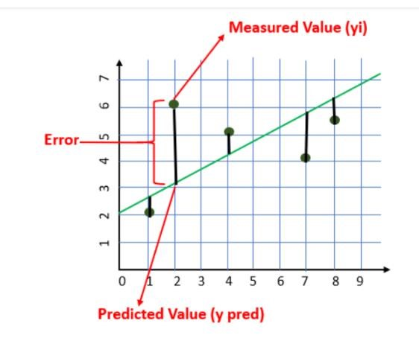
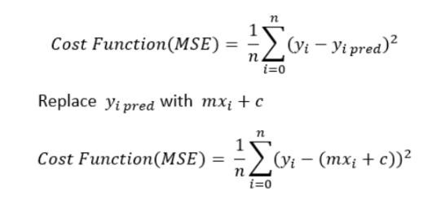

GRADIENT DESCENT
Cost Function :
• The cost is the error in our predicted value.
• It is calculated using the Mean Squared Error function as shown in fig. below
• The goal is to minimize the cost as much as possible in order to find the best fit line.

Slide 30
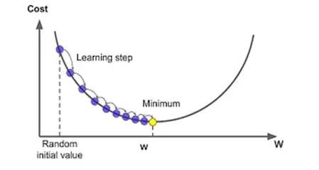
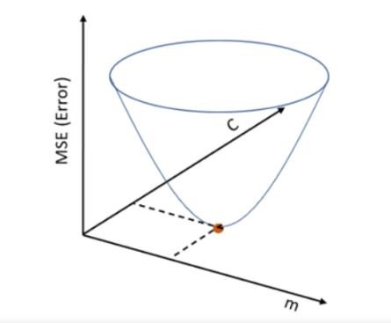
GRADIENT DESCENT ALGORITHM
• Gradient descent is an optimization algorithm that finds the best-fit line for a given training dataset in a smaller number of iterations.
• If m and c are plotted against MSE, it will acquire a bowl shape as shown in figure a &b
Fig. a - Process of gradient descent algorithm
Fig. b – Gradient Descent Shape

Slide 31
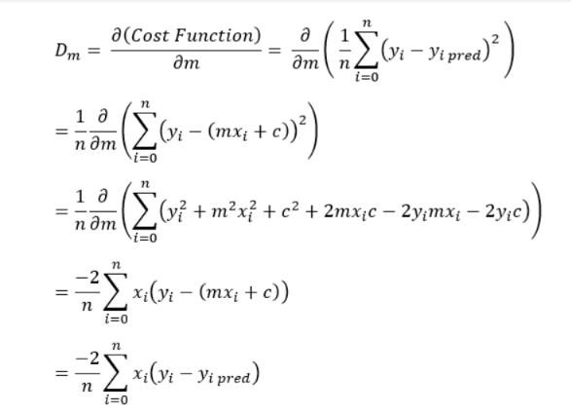
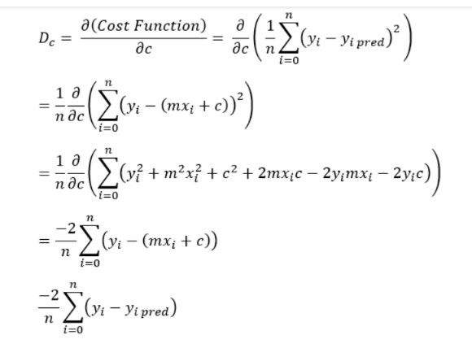
STEP BY STEP ALGORITHM
Initially, let m = 0, c = 0
Where L = learning rate - controlling how much the value of “m” changes with each step.
The smaller the L, greater the accuracy. L = 0.001 for a good accuracy.
Calculating the partial derivative of loss function “m” to get the derivative D.

Slide 32


HYPOTHESIS SPACE
2. Find the partial derivative with respect to c ,Dc
• Update the current values of m and c using the following equation:
• Repeat this process until our Cost function is very small (ideally 0).

Slide 33
LINEAR CLASSIFICATION MODELS
• The Classification algorithm is a Supervised Learning technique that is used to identify the category of new observations on the basis of training data.
• In Classification, a program learns from the given dataset or observations and then classifies new observation into a number of classes or groups.
• Such as, Yes or No, 0 or 1, Spam or Not Spam, cat or dog, etc.
• Classes can be called as targets/labels or categories.
• The output variable of Classification is a category, not a value, such as "Green or Blue", "fruit or animal", etc.
• Since the Classification algorithm is a supervised learning technique, hence it takes labeled input data, which means it contains input with the corresponding output.

Slide 34
LINEAR CLASSIFICATION MODELS
• In classification algorithm, a discrete output function(y) is mapped to input variable(x).
y=f(x), where y = categorical output
• The best example of an ML classification algorithm is Email Spam Detector.
• The goal of the classification algorithm is
o Take a D-dimensional input vector x
o Assign it to one of K discrete classes Ck , k = 1, . . . , K
• In the most common scenario, the classes are taken to be disjoint and each input is assigned to one and only one class
• The input space is divided into decision regions
• The boundaries of the decision regions :
o decision boundaries o decision surfaces
• With linear models for classification, the decision surfaces are linear functions, Classes that can be separated well by linear surfaces are linearly separable.

Slide 35
LINEAR CLASSIFICATION MODELS
If the classification problem has only two possible outcomes, it is called as Binary Classifier.
o There is a single target variable t {0, 1}
o t = 1 represents class C1
o t = 0 represents class C2
Examples: YES or NO, MALE or FEMALE, SPAM or NOT SPAM, CAT or DOG, etc.
If a classification problem has more than two outcomes, it is called as Multi-class Classifier.
Example: Classifications of types of crops, Classification of types of music.
o 1-of-K coding scheme
o There is a K-long target vector t, such that
If the class is Cj, all elements tk of t are zero for k ≠ j and one for k = j tk is the probability that the class is Ck, K = 6 and Ck = 4, then t = (0, 0, 0, 1, 0, 0)T
The simplest approach to classification problems is through construction of a discriminant function that directly assigns each vector x to a specific class

Slide 36
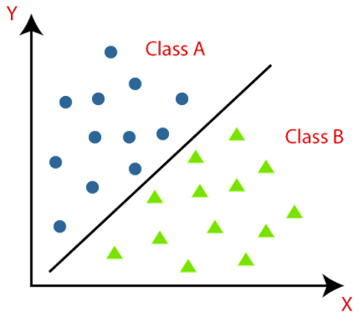
LINEAR CLASSIFICATION MODELS
The algorithm which implements the classification on a dataset is known as a classifier.
There are two types of Classifications:
Two class problems :
Binary representation or Binary Classifier:
• These classes have features that are similar to each other and dissimilar to other classes.

Slide 37
TYPES OF ML CLASSIFICATION ALGORITHMS
Types of ML Classification Algorithms:
• Logistic Regression
• K-Nearest Neighbors
• Support Vector Machines
• Kernel SVM
• Naïve Bayes
• Decision Tree Classification
• Random Forest Classification

Slide 38
DISCRIMINANT FUNCTION
• A function of a set of variables that is evaluated for samples of events or objects and used as an aid in discriminating between or classifying them.
• A discriminant function (DF) maps independent (discriminating) variables into a latent variable D.
• DF is usually postulated to be a linear function:
D = a0 + a1 x1 + a2 x2 ... aNxN
• The goal of discriminant analysis is to find such values of the coefficients {ai, i=0,...,N} that the distance between the mean values of DF is maximal for the two groups.
• Whenever there is a requirement to separate two or more classes having multiple features efficiently, the Linear Discriminant Analysis model is considered the most common technique to solve such classification problems.

Slide 39
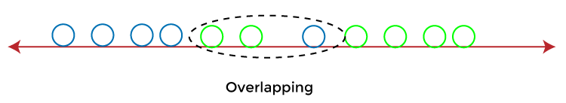
DISCRIMINANT FUNCTION
• For example, if there are classes with multiple features and need to separate them efficiently. Classify them using a single feature, then it may show overlapping as shown in fig.
Fig – Example for Classification using single feature
• To overcome the overlapping issue in the classification process, must increase the number of features regularly.

Slide 40
LINEAR DISCRIMINANT FUNCTION
A discriminant function that is a linear combination of the components of x can be written as
where w is the weight vector and w0 the bias or threshold weight.
The Two-Category Case :
• For a discriminant function of the form of eq.2.1, a two-category classifier implements the following decision rule:
• Decide w1 if g(x)>0 and w2 if g(x)<0.
• Thus, x is assigned to w1 if the inner product wTx exceeds the threshold – w0 and to w2.
• If g(x)=0, x can ordinarily be assigned to either class, or can be left undefined.
• The equation g(x)=0 defines the decision surface that separates points assigned to w1 from points assigned to w2.

Slide 41
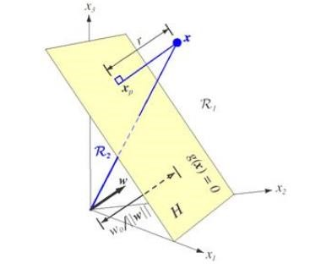
LINEAR DISCRIMINANT FUNCTION
When g(x) is linear, this decision surface is a hyperplane. • If x1 and x2 are both on the decision surface, then
or
Fig. The linear decision boundary H separates the feature space into two half-spaces.

Slide 42




LINEAR DISCRIMINANT FUNCTION
Decision region R1 for w1
region R2 for w2.
The discriminant function g(x) gives an algebraic measure of the distance from x to the hyperplane.
The way to express x as,
where xp is the normal projection of x onto H, and r is the desired algebraic distance which is positive if x is on the positive side and negative if x is on the negative side. Then, because g(xp)=0,

Slide 43

LINEAR DISCRIMINANT FUNCTION
(or)
The distance from the origin to H is given by .
If w0>0, the origin is on the positive side of H, and if w0<0, it is on the negative side.
If w0=0, then g(x) has the homogeneous form, the hyperplane passes through the origin

Slide 44
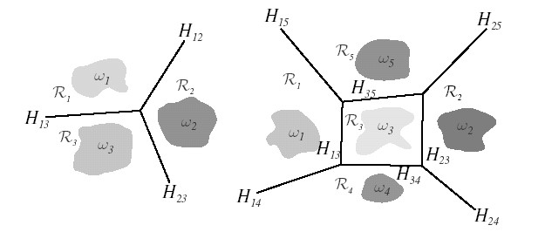
MULTI-CATEGORY CASE
To devise multi category classifiers employing linear discriminant functions reduce the problem to c two-class problems
Defining c linear discriminant functions
And assigning x to w_{i} if for all j¹ i in th ecase of ties, the classification is left undefined
The resulting classifier is called a linear machine
Fig. Decision boundaries defined by linear machines

Slide 45



LINEAR DISCRIMINANT FUNCTION
• A linear machine divides the feature space into c decision regions as shown in above fig. with gj(x) being the largest discriminant if x is in region Ri.
• If Ri and Rj are contiguous, the boundary between them is a portion of the hyperplane Hij defined by
or
is normal to Hij and the signed distance from x to Hij is given by
Generalized Linear Discriminant Functions
• The linear discriminant function g(x) can be written as
where the coefficients w_{i} are the components of the weight vector w.
Quadratic Discriminant Function:

Slide 46

Probabilistic discriminative models
• Discriminative models are a class of supervised machine learning models which make predictions by estimating conditional probability P(y|x).
• For the two-class classification problem, the posterior probability of class C1 can be written as a logistic sigmoid acting on a linear function of x
• For the multi-class case, the posterior probability of class Ck is given by a softmax transformation of a linear function of x

Slide 47
LOGISTICS REGRESSION
Logistic regression is the Machine Learning algorithms, under the classification algorithm of Supervised Learning technique.
Logistic regression is used to describe data and the relationship between one dependent variable and one or more independent variables.
The independent variables can be nominal, ordinal, or of interval type.
Logistic regression predicts the output of a categorical dependent variable.
Therefore the outcome must be a categorical or discrete value.
It can be either Yes or No, 0 or 1, true or False, etc. it gives the probabilistic values which lie between 0 and 1.
Linear Regression is used for solving Regression problems, whereas Logistic regression is used for solving the classification problems.
The fig. below predicts the logistic function

Slide 48
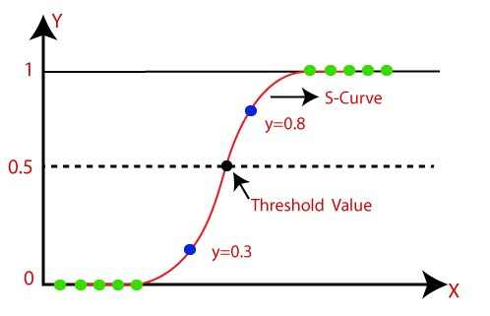
LINEAR DISCRIMINANT FUNCTION
Fig. Logistic Function or Sigmoid Function
The logistic function is also known as the sigmoid function.
The sigmoid function is a mathematical function used to map the predicted values to probabilities.
The value of the logistic regression must be between 0 and 1, so it forms a curve like the "S" form.
The S-form curve is called the Sigmoid function or the logistic function.

Slide 49


LOGISTIC REGRESSION EQUATION
The Logistic regression equation can be obtained from the Linear Regression equation.
The mathematical steps are given below:
The equation of the straight line can be written as:
In Logistic Regression y can be between 0 and 1 only, let's divide the above equation by (1-y):
For the range between -[infinity] to +[infinity], take logarithm of the equation:
The above equation is the final equation for Logistic Regression.

Slide 50
LINEAR DISCRIMINANT FUNCTION
Type of Logistic Regression:
Binomial: In binomial Logistic regression, there can be only two possible types of the dependent variables, such as 0 or 1, Pass or Fail, etc.
Multinomial: In multinomial Logistic regression, there can be 3 or more possible unordered types of the dependent variable, such as "cat", "dogs", or "sheep"
Ordinal: In ordinal Logistic regression, there can be 3 or more possible ordered types of dependent variables, such as "low", "Medium", or "High".
Steps in Logistic Regression:
• Data Pre-processing step
• Fitting Logistic Regression to the Training set
• Predicting the test result
• Test accuracy of the result
• Visualizing the test set result.

Slide 51


PROBABILISTIC GENERATIVE MODEL
• Given a model of one conditional probability, and estimated probability distributions for the variables X and Y, denoted P(X) and P(Y), can estimate the conditional probability using Bayes' rule:
Model is a statistical model of
• A generative the joint probability distribution on given observable variable X and target variable Y.
Given a generative model for P(X|Y), can estimate:
• A discriminative model is a model of the conditional probability of the target Y, given an observation xgiven a discriminative model for P(Y|X), can estimate:
• Classifier based on a generative model is a generative classifier, while a classifier based on a discriminative model is a discriminative classifier

Slide 52
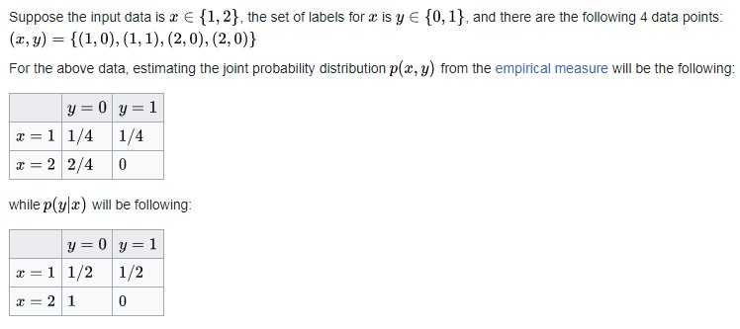
PROBABILISTIC GENERATIVE MODEL EXAMPLE

Slide 53
PROBABILISTIC GENERATIVE MODEL
Generative models :
Types of generative models are:
Naïve Bayes classifier or Bayesian network
Linear Discriminant Analysis
Discriminative models :
Logistic regression
Support Vector Machines
Decision Tree Learning
Random Forest

Slide 54
SUPPORT VECTOR MACHINE
• Support Vector Machine(SVM) is a supervised machine learning algorithm used for both classification and regression.
• The objective of SVM algorithm is to find a hyperplane in an N-dimensional space that distinctly classifies the data points.
• Hyperplanes are decision boundaries that help classify the data points.
• The dimension of the hyperplane depends upon the number of features.
• If the number of input features is 2, then the hyperplane is just a line.
• If the number of input features is 3, then the hyperplane becomes a two dimensional plane.
• It becomes difficult to imagine when the number of features exceeds 3.
• The objective is to find a plane that has the maximum margin, i.e the maximum distance between data points of both classes.
• Support vectors are data points that are closer to the hyperplane and influence the position and orientation of the hyperplane.

Slide 55
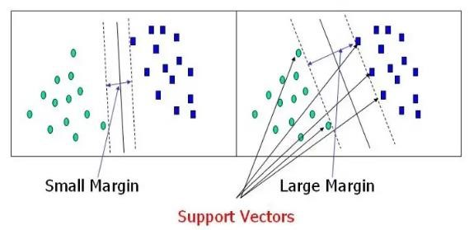
SUPPORT VECTOR MACHINE
Fig. Example for Support Vectors

Slide 56
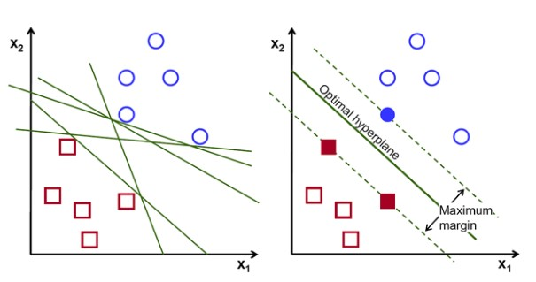
SUPPORT VECTOR MACHINE
Fig. Linearly Separable Data points

Slide 57
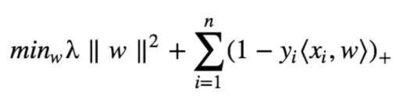
COST FUNCTION AND GRADIENT UPDATES
In the SVM algorithm, to maximize the margin between the data points and the hyperlane, the loss function helps to maximise the margin is called hinge loss.
Hinge loss function :
• The cost is 0 if the predicted value and the actual value are of the same sign. If they are not, then calculate the loss value.
• The objective of the regularization parameter is to balance the margin maximization and loss.
• After adding the regularization parameter, the cost functions looks as below.

Slide 58
LINEAR DISCRIMINANT FUNCTION

Slide 59
LINEAR DISCRIMINANT FUNCTION
SVM Kernel:
The SVM kernel is a function that takes low dimensional input space and transforms it into higher-dimensional space, ie it converts non separable problem to separable problem. It is mostly useful in nonlinear separation problems.
Types of SVMs :
There are two different types of SVMs, each used for different things:
Simple SVM: Typically used for linear regression and classification problems.
Kernel SVM: Has more flexibility for non-linear data.
Applications :
SVMs are helpful in text and hypertext categorization.
Classification of images can also be performed using SVMs.
Classification of satellite data like SAR data using supervised SVM.
Hand-written characters can be recognized using SVM.
The SVM algorithm has been widely applied in the biological and other sciences. They have been used to classify proteins with up to 90% of the compounds classified correctly.

Slide 60
DECISION TREE
• Decision Tree is a supervised learning technique that can be used for both classification and Regression problems.
• It is a tree-structured classifier, where internal nodes represent the features of a dataset, branches represent the decision rules and each leaf node represents the outcome.
• In a Decision tree, there are two nodes, the Decision Node and Leaf Node.
• As shown in fig. below, Decision nodes are used to make any decision and have multiple branches, whereas Leaf nodes are the output of those decisions and do not contain any further branches.
• The goal of using a Decision Tree is to create a training model that can use to predict the class or value of the target variable by learning simple decision rules inferred from prior data(training data).
• In order to build a tree, use the CART algorithm, which stands for Classification and Regression Tree algorithm.

Slide 61
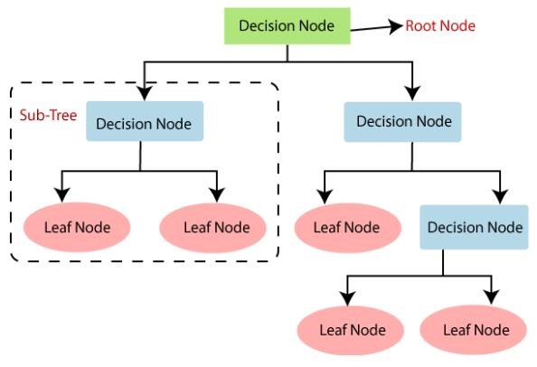
DECISION TREE
Fig. Decision Tree Structure

Slide 62
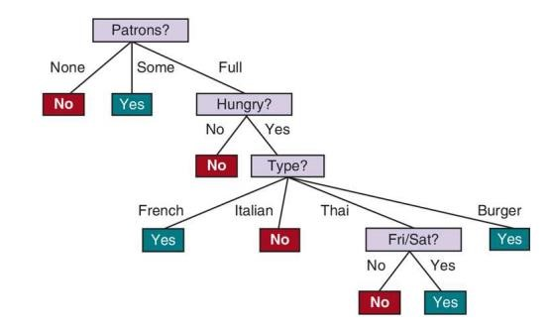
DECISION TREE
Fig. Decision Tree Example

Slide 63
DECISION TREE
Types of Decision Trees :
1. Categorical Variable Decision Tree: Decision Tree which has a categorical target variable then it is called a Categorical variable decision tree.
Continuous Variable Decision Tree: Decision Tree has a continuous target variable then it is called Continuous Variable Decision Tree.
Reason for using Decision Trees :
• Decision Trees usually mimic human thinking ability while making a decision, so it is easy to understand.
• The logic behind the decision tree can be easily understood because it shows a tree-like structure.

Slide 64
DECISION TREE
Decision Tree Terminologies :
• Root Node: Root node is from where the decision tree starts. It represents the entire dataset, which further gets divided into two or more homogeneous sets.
• Leaf Node: Leaf nodes are the final output node, and the tree cannot be segregated further after getting a leaf node.
• Splitting: Splitting is the process of dividing the decision node/root node into sub-nodes according to the given conditions.
• Branch/Sub Tree: A tree formed by splitting the tree.
• Pruning: Pruning is the process of removing the unwanted branches from the tree.
• Parent/Child node: The root node of the tree is called the parent node, and other nodes are called the child nodes.

Slide 65
WORKING OF DECISION TREE ALGORITHM
• In a decision tree, for predicting the class of the given dataset, the algorithm starts from the root node of the tree.
• This algorithm compares the values of root attribute with the record (real dataset) attribute and, based on the comparison, follows the branch and jumps to the next node.
• For the next node, the algorithm again compares the attribute value with the other sub-nodes and move further.
• It continues the process until it reaches the leaf node of the tree.
• The complete process can be better understood using the below algorithm:

Slide 66
DECISION TREE
Step-1: Begin the tree with the root node, says S, which contains the complete dataset.
Step-2: Find the best attribute in the dataset using Attribute Selection Measure (ASM).
Step-3: Divide the S into subsets that contains possible values for the best attributes.
Step-4: Generate the decision tree node, which contains the best attribute.
Step-5: Recursively make new decision trees using the subsets of the dataset created in step -3. Continue this process until a stage is reached where cannot further classify the nodes and called the final node as a leaf node.
Example:
• Suppose there is a candidate who has a job offer and wants to decide whether he should accept the offer or Not. So, to solve this problem, the decision tree starts with the root node (Salary attribute by ASM). The root node splits further into the next decision node (distance from the office) and one leaf node based on the corresponding labels. The next decision node further gets split into one decision node (Cab facility) and one leaf node. Finally, the decision node splits into two leaf nodes (Accepted offers and
Declined offer).

Slide 67
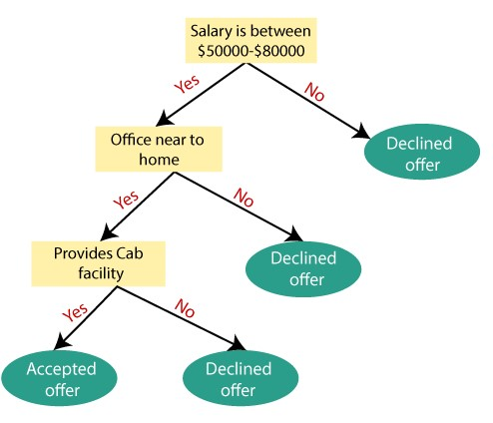
DECISION TREE
Fig. Decision Tree Algorithm Example

Slide 68
DECISION TREE
Algorithms used to construct Decision Trees:
• ID3 → (extension of D3)
• C4.5 → (successor of ID3)
• CART → (Classification And Regression Tree)
• CHAID → (Chi-square automatic interaction detection - Performs multi-level splits when computing classification trees)
• MARS → (Multivariate adaptive regression splines)
Attribute Selection Measures :
• While implementing a Decision tree, Attribute selection measure or ASM is used to select the best attribute for the nodes of the tree.
1. Entropy, 2. Information gain,
3. Gini index, 4. Gain Ratio,
5 Reduction in Variance 6. Chi-Square

Slide 69
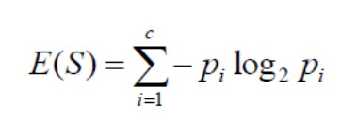
ENTROPY
Entropy:
Entropy is a metric to measure the impurity in a given attribute.
Entropy is a measure of the randomness in the information being processed.
The higher the entropy, the harder it is to draw any conclusions from that information.
Flipping a coin is an example of an action that provides information that is random.
Entropy can be calculated as:
Entropy(S) = P(yes)log P(yes) P(no) log P(no) log
Where,
S = Total number of samples
P(yes) = probability of yes
P(no) = probability of no

Slide 70
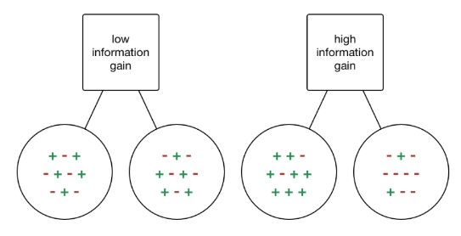
INFORMATION GAIN
• Information gain or IG is a statistical property that measures how well a given attribute separates the training examples according to their target classification.
Fig – Information Gain Example

Slide 71

DECISION TREE
• Constructing a decision tree is all about finding an attribute that returns the highest information gain and the smallest entropy.
• Information gain is a decrease in entropy.
• It computes the difference between entropy before split and average entropy after split of the dataset based on given attribute values.
• It can be calculated using the below formula:
Information Gain = Entropy(S) - [(Weighted Avg) *Entropy(each feature)]

Slide 72
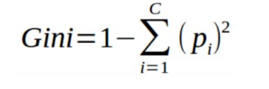

DECISION TREE
Gini Index :
• Gini index as a cost function used to evaluate splits in the dataset.
• It is calculated by subtracting the sum of the squared probabilities of each class from one.
• It favors larger partitions and easy to implement whereas information gain favors smaller partitions with distinct values.
• Gini index can be calculated using this formula:
Gain Ratio :
• Information gain is biased towards choosing attributes with a large number of values as root nodes.
• Gain ratio overcomes the problem with information gain by taking the intrinsic information of a split into account.

Slide 73
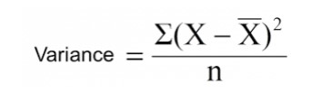
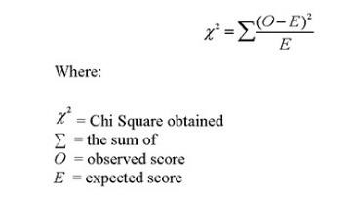
DECISION TREE
Reduction in variance :
• Reduction in variance is an algorithm that uses the standard formula of variance to choose the best split.
• The split with lower variance is selected as the criteria to split the population:
Chi-Square :
• Generates a tree called CHAID (Chi-squared Automatic Interaction Detector).
• It finds out the statistical significance between the differences between sub-nodes and parent node.
• Higher the value of Chi-Square higher the statistical significance of differences between sub-node and parent node.
• Chi-squared is represented as:

Slide 74
DECISION TREE
Avoid/counter Overfitting in Decision Trees:
Two ways to remove overfitting:
• Pruning Decision Trees.
• Random Forest
Pruning Decision Trees :
• Pruning is a process of deleting the unnecessary nodes from a tree in order to get the optimal decision tree.
• A too-large tree increases the risk of over fitting, and a small tree may not capture all the important features of the dataset.
• Therefore, a technique that decreases the size of the learning tree without reducing accuracy is known as Pruning.
• There are mainly two types of tree pruning technology used:
o Cost Complexity Pruning
o Reduced Error Pruning.

Slide 75
DECISION TREE
Advantages of the Decision Tree:
• It is simple to understand as it follows the same process which a human follow while making any decision in real-life.
• It can be very useful for solving decision-related problems.
• It helps to think about all the possible outcomes for a problem.
• There is less requirement of data cleaning compared to other algorithms.
Disadvantages of the Decision Tree:
• The decision tree contains lots of layers, which makes it complex.
• It may have an over fitting issue, which can be resolved using the Random Forest algorithm.
• For more class labels, the computational complexity of the decision tree may increase.

Slide 76
RANDOM FOREST
Random Forest :
• Random Forest is a classifier that contains a number of decision trees on various subsets of the given dataset and average result is taken to improve the predictive accuracy of that dataset.
• Random Forest is a popular machine learning algorithm that belongs to the supervised learning technique.
• It can be used for both Classification and Regression problems in ML.
• It is based on the concept of ensemble learning, which is a process of combining multiple classifiers to solve a complex problem and to improve the performance of the model.
• The greater number of trees in the forest leads to higher accuracy and prevents the problem of over fitting.
Steps in the working process of Random Forest :
• The Working process can be explained in the below steps and diagram:
Step 1: In Random forest n no. of random records are taken from the data set having k number of records.
Step 2: Individual decision trees are constructed for each sample.
Step 3: Each decision tree will generate an output.
Step 4: Final output is considered based on Majority Voting or Averaging for Classification and regression.

Slide 77
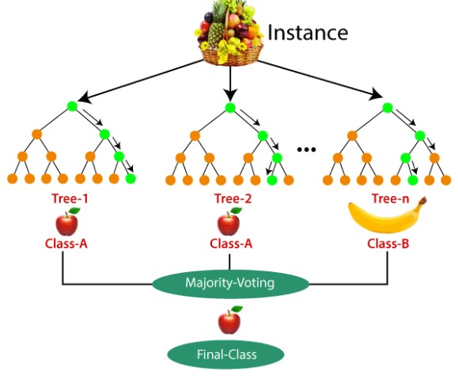
RANDOM FOREST

Slide 78
RANDOM FOREST
Important Features of Random Forest:
Not all attributes/variables/features are considered while making an individual tree, each tree is different.
Immune to the curse of dimensionality-
Since each tree does not consider all the features, the feature space is reduced.
3. Parallelization-
Each tree is created independently out of different data and attributes. This means that we can make full use of the CPU to build random forests.
4. Train-Test split-
In a random forest we don’t have to segregate the data for train and test as there will always be 30% of the data which is not seen by the decision tree.
5. Stability-
Stability arises because the result is based on majority voting/ averaging.

Slide 79
DECISION TREE
Applications of Random Forest :
Classification Tasks
Regression Tasks
Feature Selection
Anomaly Detection
Recommendation Systems
Biological and Genomic Studies
Image and Text Processing
Predictive Modeling

Slide 80
RANDOM FOREST
Advantages of Random Forest :
1. High Accuracy
2. Handles Missing Data
3. Works Well with Large Datasets
4. Reduces Overfitting
5. Handles Both Classification and Regression
6. Robust to Outliers and Noise
7. Feature Importance
8. Resistant to Overfitting in Large Datasets
9. Good Performance Without Extensive Hyperparameter Tuning
10. Flexibility
11. Works Well with Categorical and Continuous Data
12. Parallelizable

Slide 81
RANDOM FOREST
Disadvantages of Random Forest :
High Computational Cost
2. Memory Intensive
Risk of Overfitting
Low Interpretability
Slow Predictions
Struggles with High-Dimensional Sparse Data
Bias with Categorical Features
Poor Performance on Small Datasets
Handles Imbalanced Data Poorly
Tuning Dependency

Slide 82
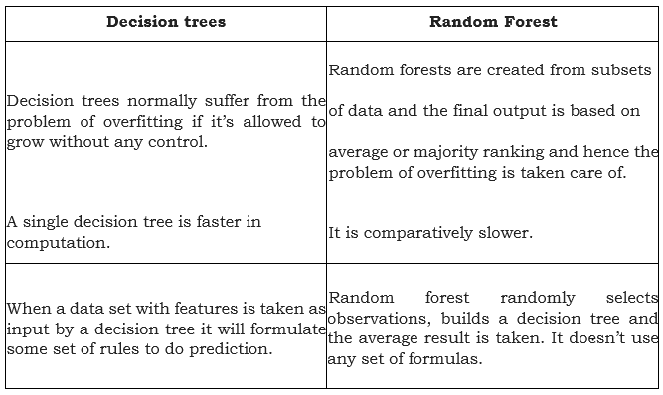
DECISION TREE

Slide 83
DECISION TREE
THANK YOU…

